Slide 1
Rx Drug Abuse
prevention
Lane County Public Health
Notes:
What’s happening in prevention in Lane County? What sort of prevention is happening specific to alcohol and drugs?

Slide 2
Lane County Public Health Prevention Program
Alcohol
drugs
Gambling
gangs
Health equity
healthy Eating
Mental health
Physical activity
Suicide
Tobacco/ e-Cigs

Slide 3
Health starts with where people
live, work, learn & play
and that individual and community health is influenced by more than just individual choices.
Notes:
What is Health in All Policies?
Health in All Policies or “healthy public policy” is based on the idea that health starts with where people live, work, learn & play and that individual and community health is influenced by more than just individual choices
Health in All Policies is governed by several key principles:
Health starts long before illness – it starts in our families, schools, workplaces and communities
All individuals should have the opportunity to make the choices that allow them to live long, productive lives
Lane County government can and does influence health in many of its decisions
One place to start is the programs, policies and action items that go before the Board

Slide 4
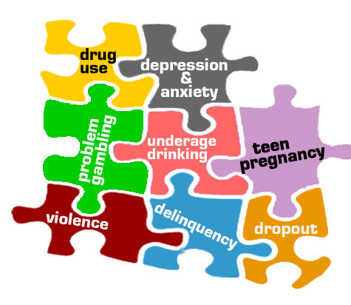
prevention
philosophy

Slide 5
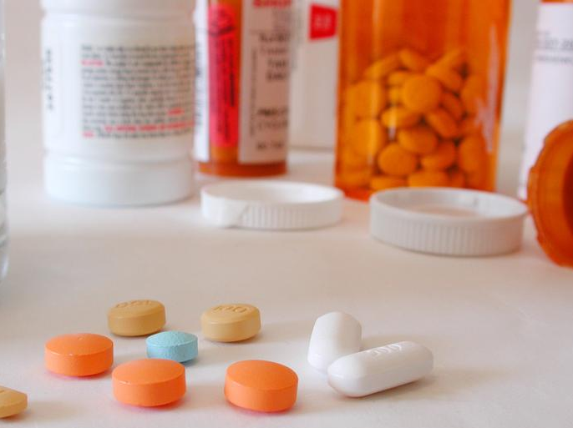
Rx drug
ab/use
Notes:
Top 3 drugs of abuse in Lane County among young adults are alcohol, marijuana, and prescription drugs.
Why do we care?

Slide 8
Motor vehicle injury is the leading cause of death among Oregonians age 10-24. What is #2?

Slide 9
SUICIDE is the 2nd leading cause of death among Oregonians age 10-24.
Source: Oregon Health Authority (2012)

Slide 10
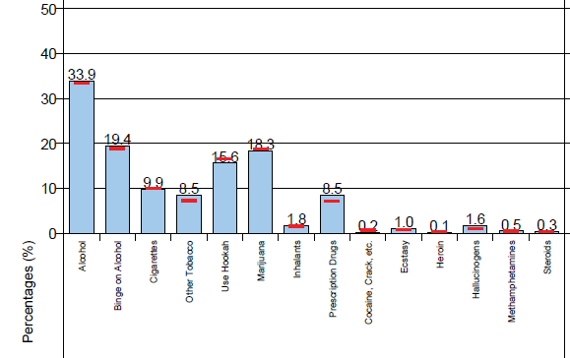
30-day use in 11th grade
11th Grade Students – past 30 days
Source: Student Wellness Survey, 2014

Slide 11
Non-Medical Pain Reliever Use in Past year by Age
Source: National Survey on Drug Use & Health

Slide 12
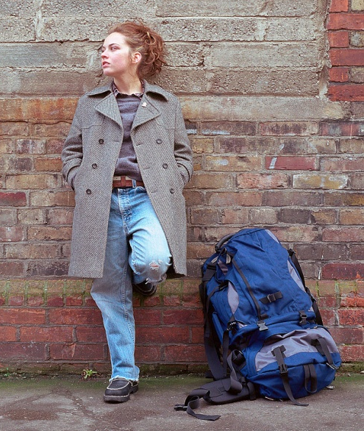
?
%
of Americans who meet the medical criteria for addiction started smoking, drinking, or using other drugs
before age 18.
Notes:
Why else does this matter?

Slide 13
90%
of Americans who meet the medical criteria for addiction started smoking, drinking, or using other drugs
before age 18.
Notes:
We have so much science and research that tells us that the earlier we can prevent a problem, experience or condition from occurring, the better the chances for positive health outcomes. The people who are costing us the most in healthcare expenses are experiencing these risk factors – alcohol or drug use, abuse, violence, etc. – at a very young age.
At what age does the brain fully develop?
25
Last part of the brain is the prefrontal cortex

Slide 14
What influences use?
Notes:
Availability
Disapproval – peer & parental
Community norms and attitudes
Perception of getting caught “enforcement”
Advertising and promotion
Price
Product placement
Will changes in laws contribute to use?

Slide 15
Availability: 6th 8th & 11th
2014 Student Wellness Survey
Percent of students that said it would be “sort of easy” or “very easy” to get…
Notes:
2014 Student Wellness Survey Data
Dark line = state average
Percent of students that said it would be “sort of easy” or “very easy” to get marijuana:
6th Lane: 7.9%
6th State: 6.4%
8th Lane: 36.6%
8th State: 29.8%
11th Lane: 65.8%
11th State: 66.0%

Slide 16
Disapproval: 6th 8th & 11th
2014 Student Wellness Survey
Percent of students that “somewhat disapprove” or “strongly disapprove” for someone their age to use…
Notes:
2014 Student Wellness Survey Data
Dark line = state average
Percent of students that “somewhat disapprove” or “strongly disapprove” for someone their age to use marijuana
6th Lane: 78.5%
6th State: 77.1%
8th Lane: 65.0%
8th State: 69.4%
11th Lane: 47.5%
11th State: 48.7%

Slide 17
Perceived harm: 6th 8th & 11th
2014 Student Wellness Survey
Percent of students that think there is “moderate risk” or “great risk” of harming themselves if they…
Notes:
2014 Student Wellness Survey Data
Dark line = state average
Percent of students that think there is “moderate risk” or “great risk” of harming themselves if they use marijuana
6th Lane: 47.8%
6th State: 50.8%
8th Lane: 30.8%
8th State: 39.9%
11th Lane: 22.2%
11th State: 22.9%

Slide 18
what does work?
multiple approaches
sustained and reinforced over a
long period of time.
prevention

Slide 19
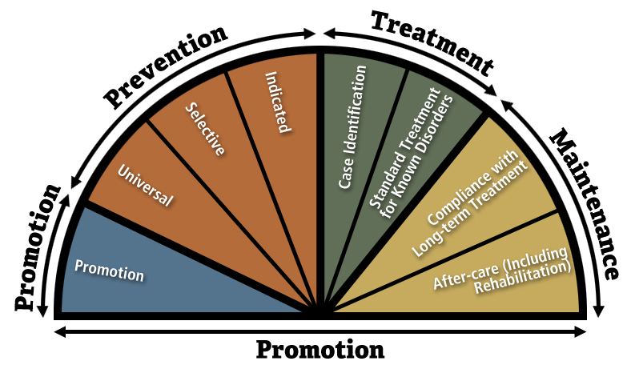
Where is Our Focus?
individual
small group
a population
Source: http://captus.samhsa.gov/prevention-practice/
Notes:
19
A really important concept that the research has taught us is that it’s most cost-effective to get the right support to the right people.
Not everyone needs the highest intensity level of intervention, but some people need more support than others.
About 75% of youth are basically doing ok and can benefit from “universal” supports – that is, basic supports provided to everyone. All families and all kids need help, guidance, and support from time to time. These are kids in the GREEN zone.
Some families and some kids need more support and guidance – about 15% or so might be considered “at risk” and would benefit from somewhat more intensive interventions and supports. These are kids in the YELLOW zone.
About 5-10% are at the top of the pyramid– these highest-risk families and kids would benefit from the highest-intensity interventions. These are kids in the RED zone.
Families and kids might be at risk for a number of reasons – Poverty, living in a high poverty/high crime neighborhoods, higher levels of stress and chaos in the family, single parenthood, marital conflict or multiple marital transitions, parental depression or substance abuse, social isolation – all of these conditions make it harder to be a good parent, provide positive opportunities, and to ensure positive influences on the child. Especially poverty. We could do a lot to alleviate these problems by alleviating poverty. But it’s important to recognize that these problems are not exclusive to poor people by any means.
Ideally, a community would have varying levels of support to meet the needs of all youth and their families at all levels of need.
19

Slide 20
BEST PRACTICE
Prescription Opioids
Provider enrollment & use of PDMP;
Set community prescribing guidelines;
Increase access to MAT and other forms of addictions treatment;
Naloxone distribution programs;
Drug take-backs and disposal sites;
Safe home storage;
Community education

Slide 21
EXAMPLES
RX ABUSE PREVENTION in action
In Lane County!

Slide 22
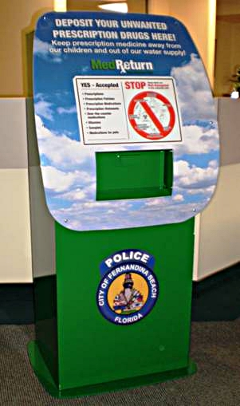
prescription
drop boxes

Slide 23
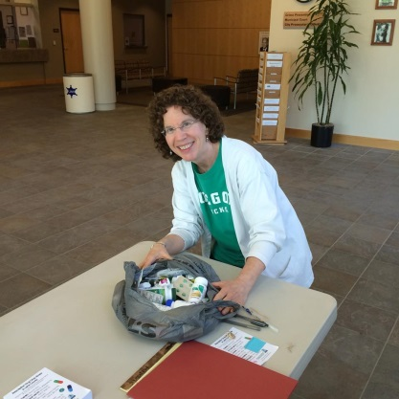
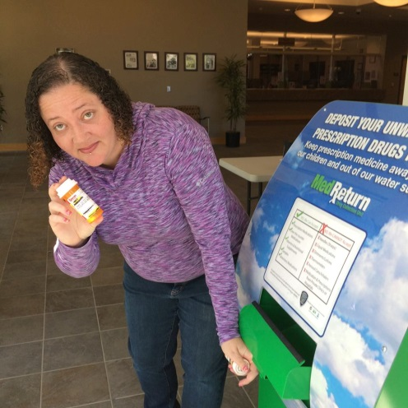
take-back
events

Slide 24
community
support

Slide 25
parent
education

Slide 26
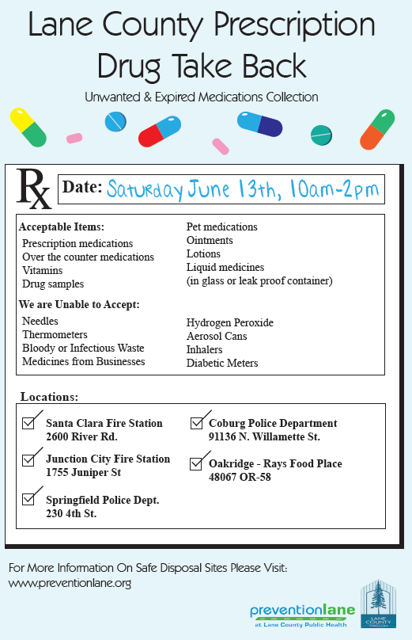
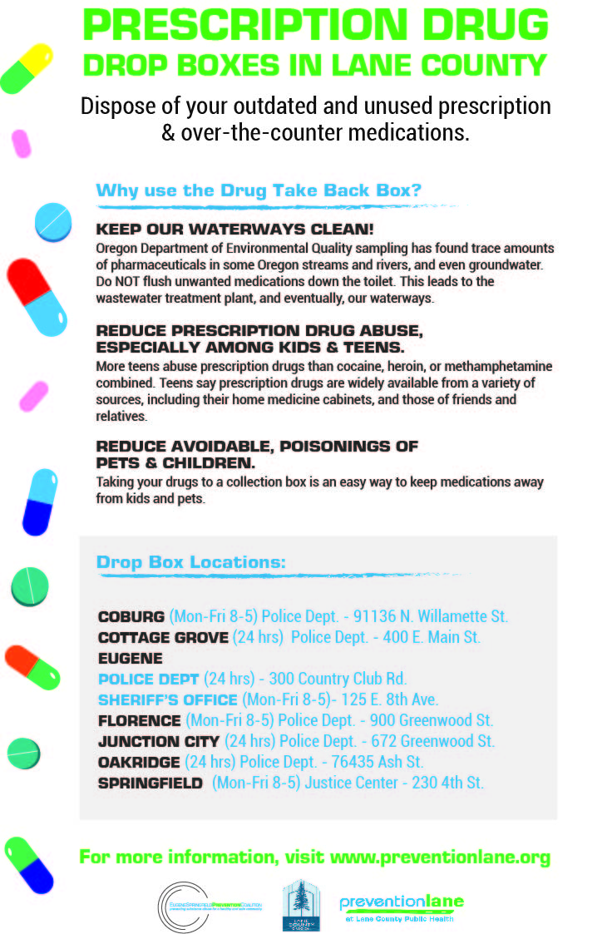
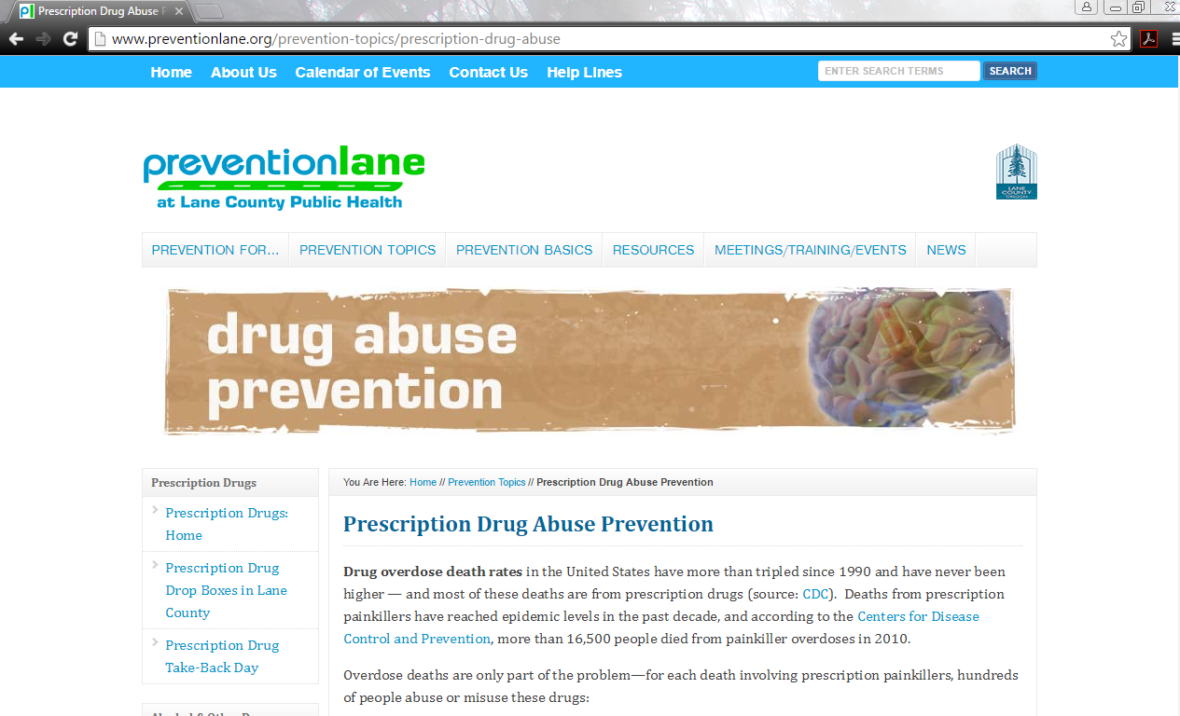
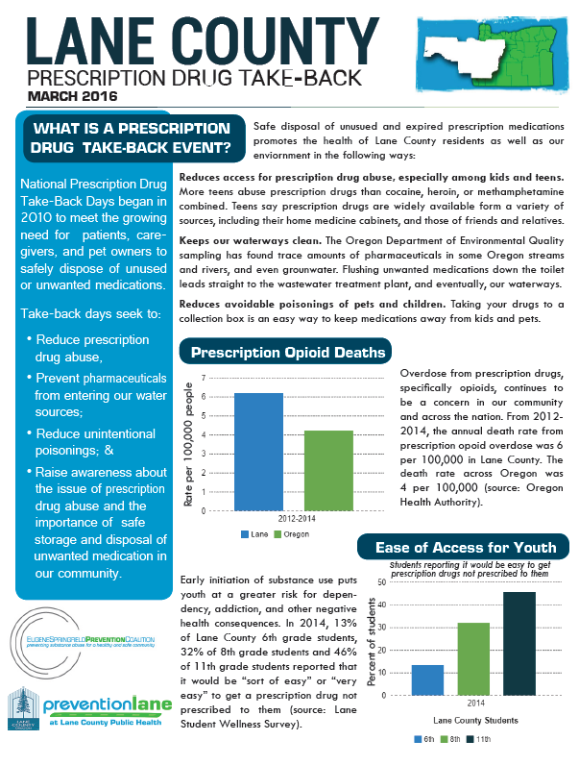
community
awareness

Slide 27
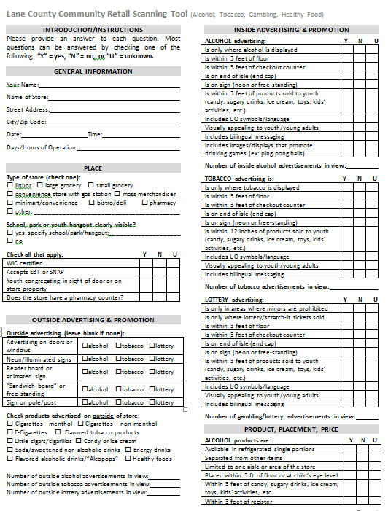
monitor &
collect data
Notes:
State and national data such as Oregon SWS and OHT
Create our own surveys such as:
Retail scanning
Community attitudes & perceptions
Program evaluation
Use this for:
Assessment as part of the SPF process (monitoring trends, understanding community)
Grant writing
Evaluation
Advocacy & education efforts

Slide 28
THANK YOU!
Connect :
preventionlane.org
facebook.com/
preventionlane
twitter.com/
preventionlane

